Slide 1


Green Pace
Security Policy Presentation
Developer: Jovan Saldana

Slide 2

OVERVIEW: DEFENSE IN DEPTH
Software development at Green Pace requires consistent implementation of secure principles to all developed applications. Consistent approaches and methodologies must be maintained through all policies that are uniformly defined, implemented, governed, and maintained over time.

Slide 3
THREATS MATRIX
Note: This is based on the Summary of risk Assessment section of the Security Policy document.
Likely STD-002-CPP STD-003-CPP STD-0010-CPP | Priority STD-004-CPP STD-005-CPP STD-007-CPP STD-008-CPP
Low priority STD-002-CPP STD-006-CPP STD-007-CPP STD-008-CPP | Unlikely STD-001-CPP STD-006-CPP STD-009-CPP

Slide 4
10 PRINCIPLES
Validate Input Data – SQL injection prevention
Heed Compiler Warnings – using static analysis tools for eliminating security flaws
Architect and Design for Security Policies – SQL injection prevention
Keep it Simple – complexity increases the likelihood for errors
Default Deny – Access denied until conditions are met
Adhere to the Principle of Least Privilege – reducing attacker opportunity
Sanitize Data Sent to Other Systems – SQL injection prevention
Practice Defense in Depth – multiple layers of defense
Use Effective Quality Assurance Techniques – Handle all exceptions
Adopt a Secure Coding Standard – Applying secure coding standards

Slide 5
CODING STANDARDS
STD-0010-CPP
STD-001-CPP
STD-003-CPP
STD-004-CPP
STD-009-CPP
STD-005-CPP
STD-002-CPP
STD-006-CPP
STD-007-CPP
STD-008-CPP
The reason for this ranking system is primarily mirroring the “Priority” section of the Summary of Risk Assessments, where I set the highest priority coding standards at the top, followed by the medium priority ones, and then the low priorities.

Slide 6
ENCRYPTION POLICIES
Encryption in rest - A concept in where data that is not being actively utilized is encrypted. The goal of this policy is to protect data in the event of a breech and these files are stolen.
Encryption at flight - A concept where data as its moving around the network is being protected. The goal of this policy is to protect data while it’s arguably at its most vulnerable point and subject to the most exposure.
Encryption in use - A concept of protecting data when it’s actively being utilized. Protecting data-in-use is accomplished through the use of programming techniques like utilizing protected memory.

Slide 7
TRIPLE-A POLICIES
Authentication - The process in which a server or application proves that you are who you say you are. This step is obviously important, as it determines who should or shouldn’t be granted access to the application.
Authorization - The process that occurs after Authentication and grants the level of access that you have to a system, its files, and its resources. New users should not inherently have access to any resources even if authenticated and only through extensive validation and role distribution will a user have access to specific data.
Accounting - The process of tracking changes to a particular system or resource. This is an important system to have as its both informative before and after a breach, as it can document the history of the incident before, current, and after.

Slide 8
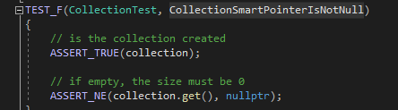
Unit Testing – CollectionSmartPointerIsNotNull

Slide 9
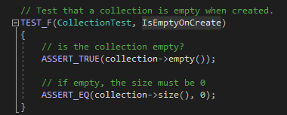
Unit Testing – IsEmptyOnCreate

Slide 10
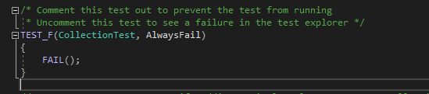
Unit Testing – AlwaysFail

Slide 11
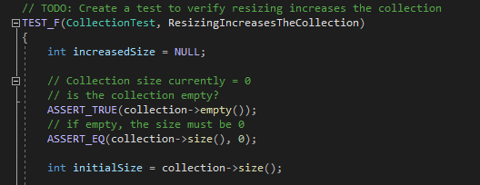
Unit Testing – ResizingIncreasesTheCollection

Slide 12

AUTOMATION SUMMARY

Slide 13
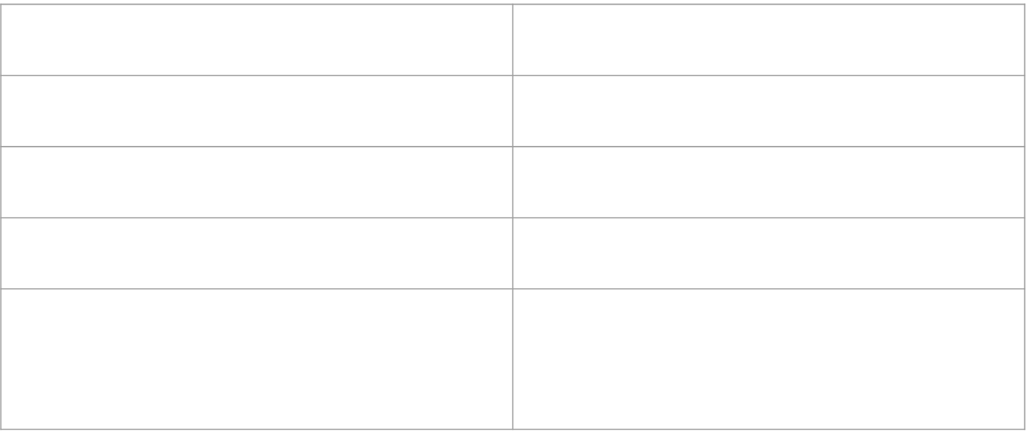
TOOLS

Slide 14
RISKS AND BENEFITS
Act Now
Secure Coding long term
Potential to have better long-term money savings
Better chance to have a more positive company reputation
Potential for delays
Can be costly since its harder to predict costs compared to acting later
Act Later
Better cost management
Potential earlier releases
Higher chance for issues to be overlooked
Possible systems/open testing results to be sent back to clear up issues

Slide 15
RECOMMENDATIONS
Have containers
Have floating point values
Having more access controls
Video cameras
ID card scanners
Fingerprint scanners
Security audits (quarterly)

Slide 16
CONCLUSIONS
standards that should be adopted to prevent future problems:
Establish security goals
Defense in Depth
Adopt a systems team or core group to test security
Grey-Hat hacker help
Begin using an ISO/NIST framework

Slide 17
REFERENCES
“Sonarsourcestatic Code ANALYSISSINCE2008.” SonarSource Rules, rules.sonarsource.com/. Accessed 18 June 2023.
“Str53-CPP. Range Check Element Access.” STR53-CPP. Range Check Element Access - SEI CERT C++ Coding Standard - Confluence, wiki.sei.cmu.edu/confluence/display/cplusplus/STR53-CPP.+Range+check+element+access. Accessed 18 June 2023.
Seacord, R. C. (2013). Secure Coding in C and C++ (2nd ed.). Pearson Technology Group. https://mbsdirect.vitalsource.com/books/9780132981972

